Slide 1
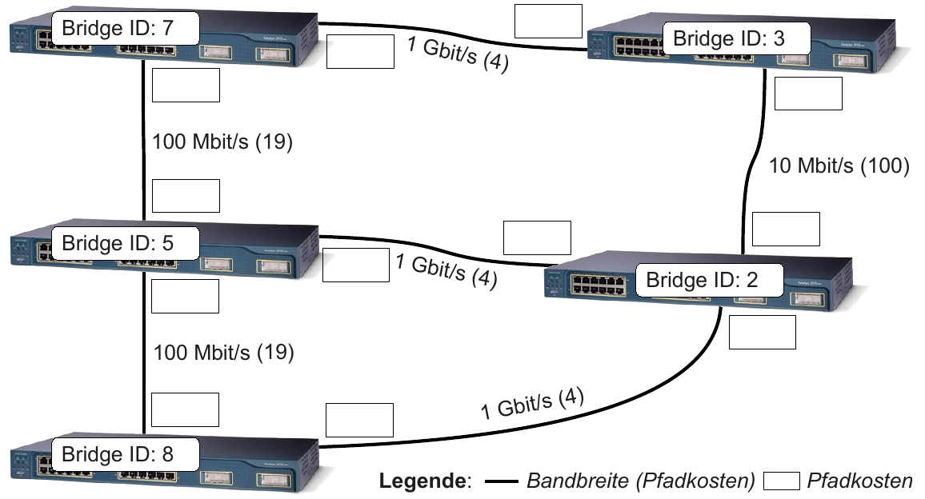
Spanning Tree Berechnung
Designated Brigde
RP (100/27/46)
Designated Brigde
DP
(104/23/42)
RP (104/23/42)
AP (100/27/46)
DP (123/4/23)
DP (127/0/27)
DP (0/127/146)
RP
(123/4/23)
Designated Brigde
AP (123/4/23)
Root Brigde
DP (146/46/0)
DP (142/42/4)
RP (142/42/4)
Designated Brigde

